Slide 1
Rodent Identification Practice

Slide 2
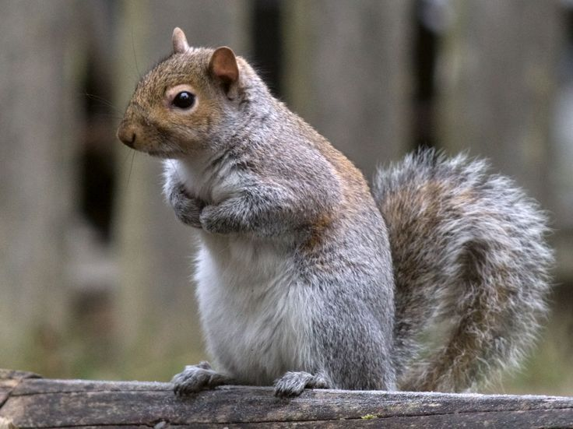
1

Slide 3
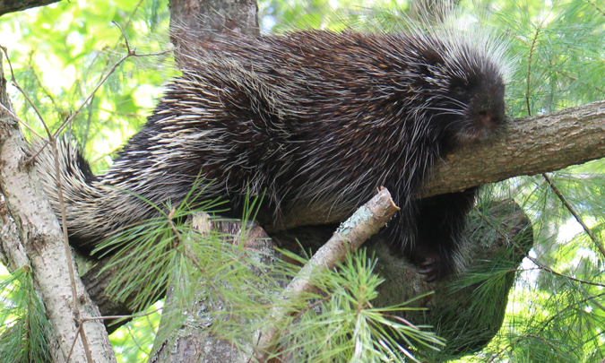
2

Slide 4
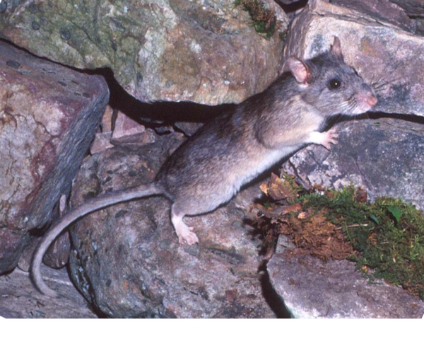
3

Slide 5
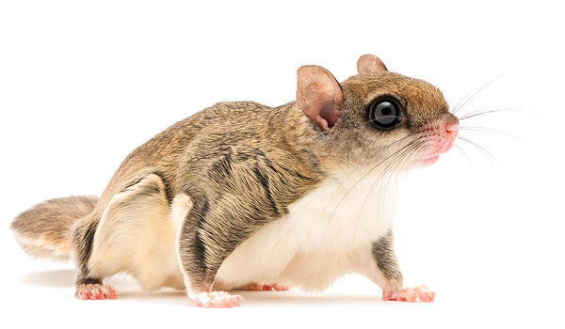
4

Slide 6
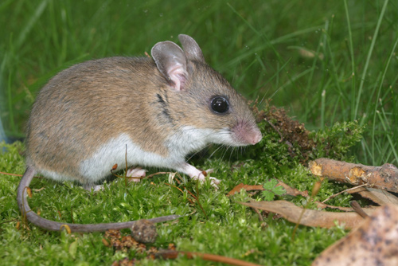
5

Slide 7
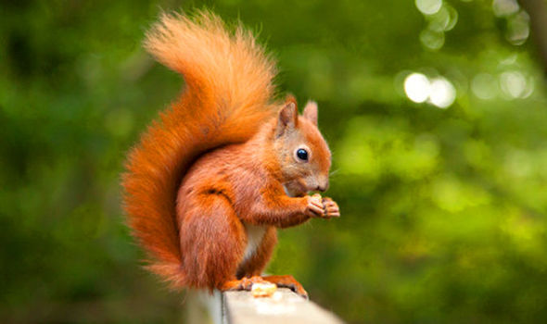
6

Slide 8
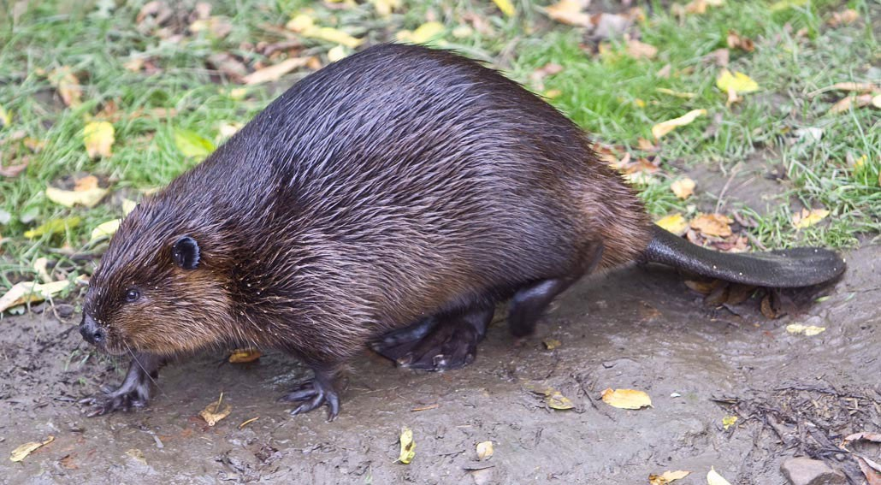
7

Slide 9
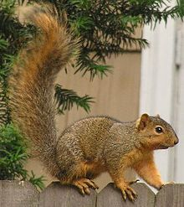
8

Slide 10
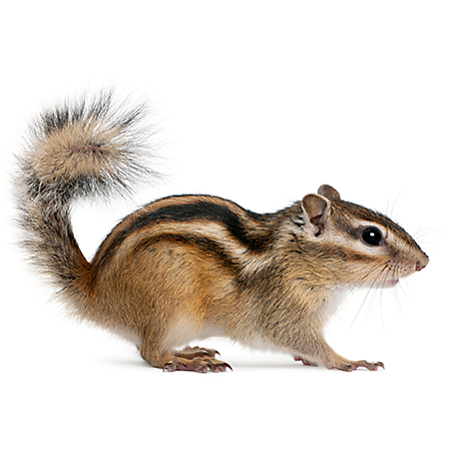
9

Slide 11
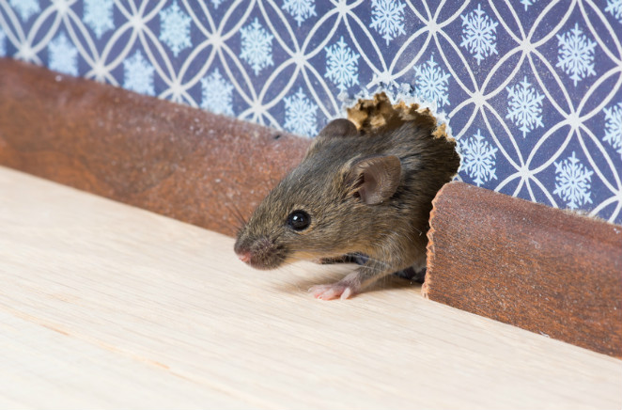
10

Slide 12
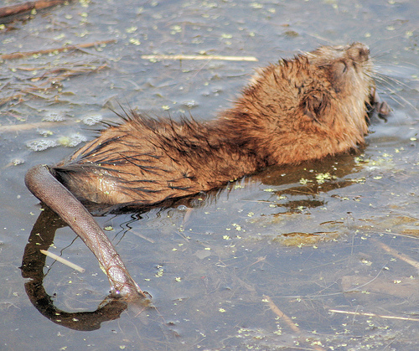
11

Slide 13
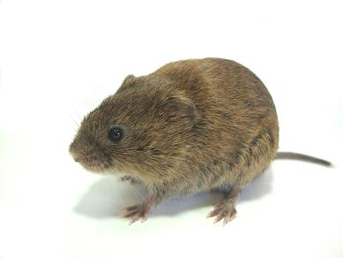
12

Slide 14
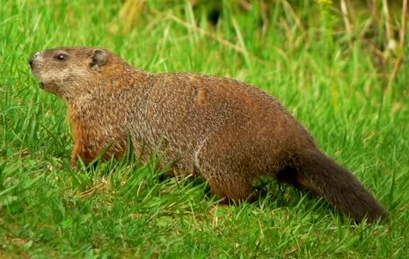
13

Slide 15
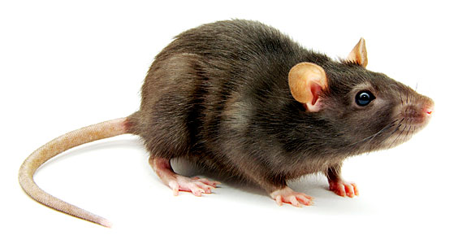
14

Slide 16
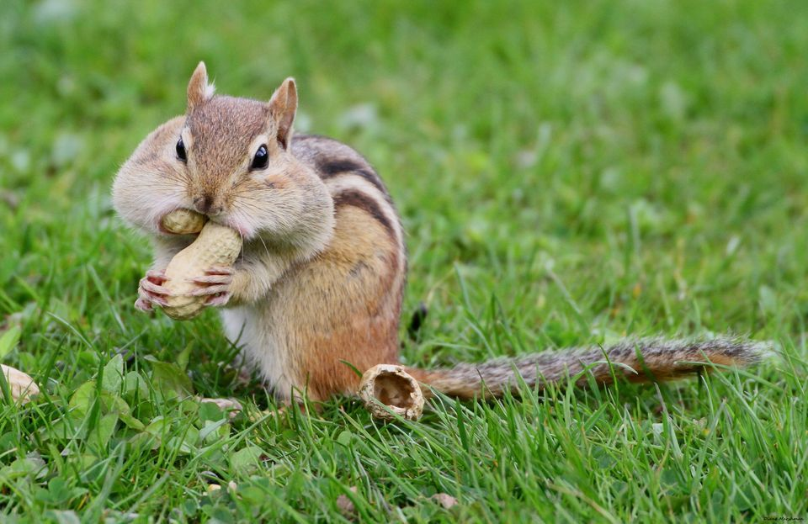
15

Slide 17
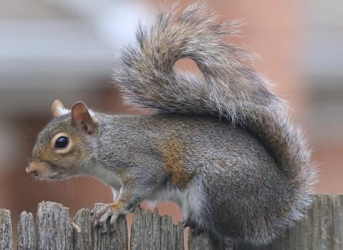
16

Slide 18
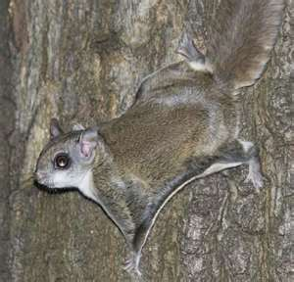
17

Slide 19
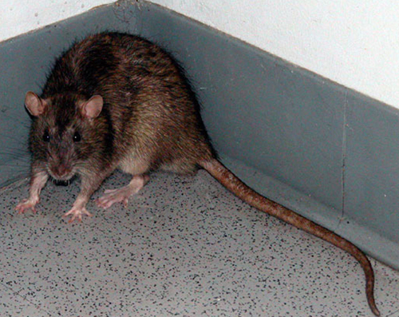
18

Slide 20
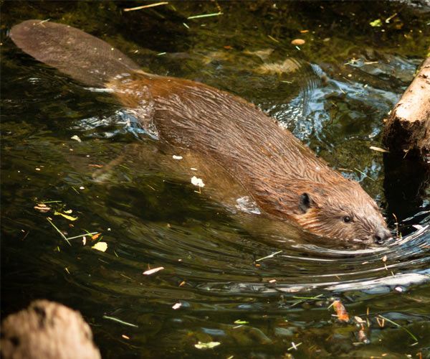
19

Slide 21
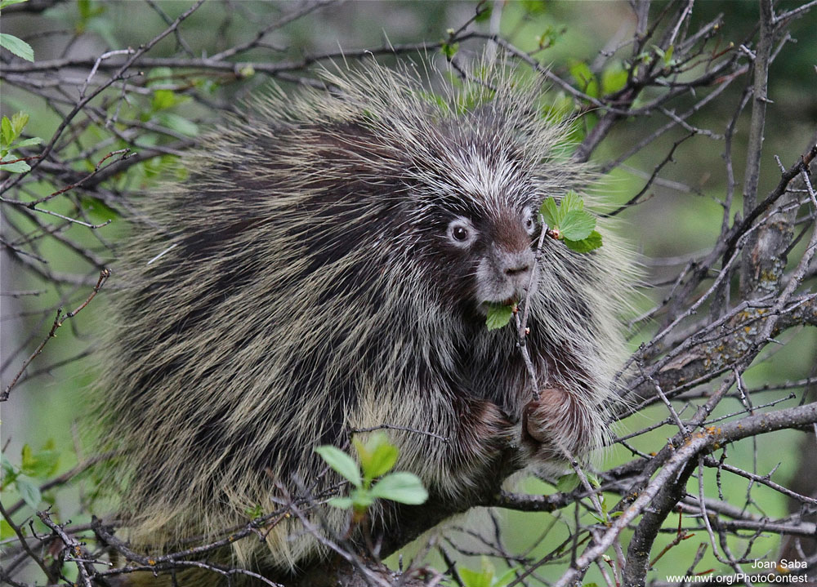
20

Slide 22
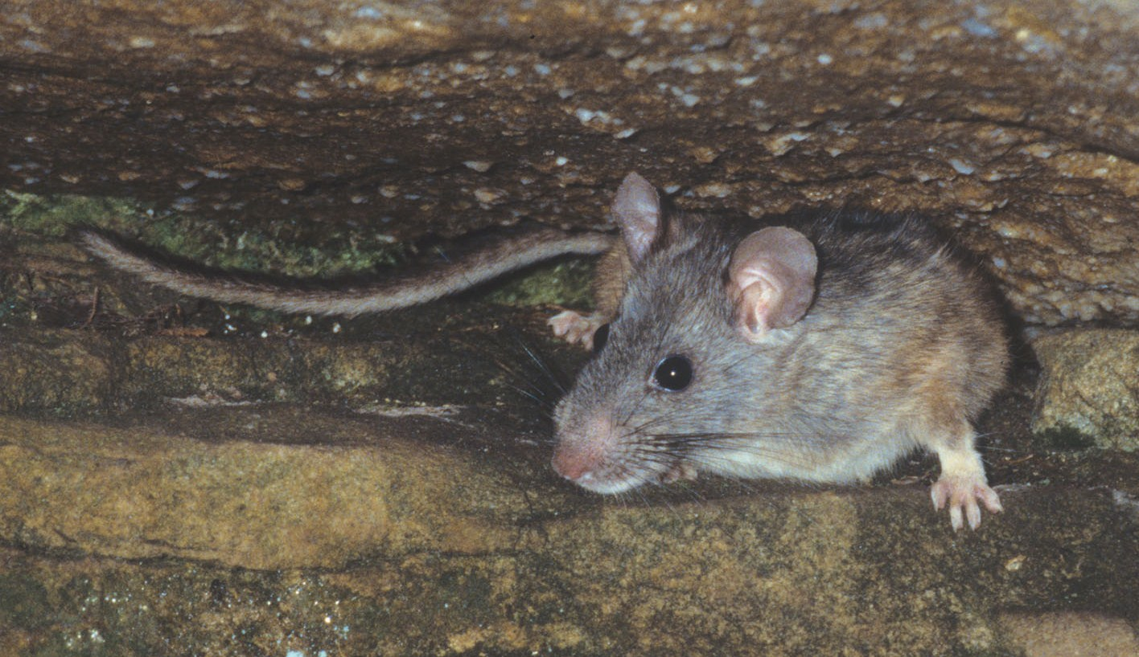
21

Slide 23
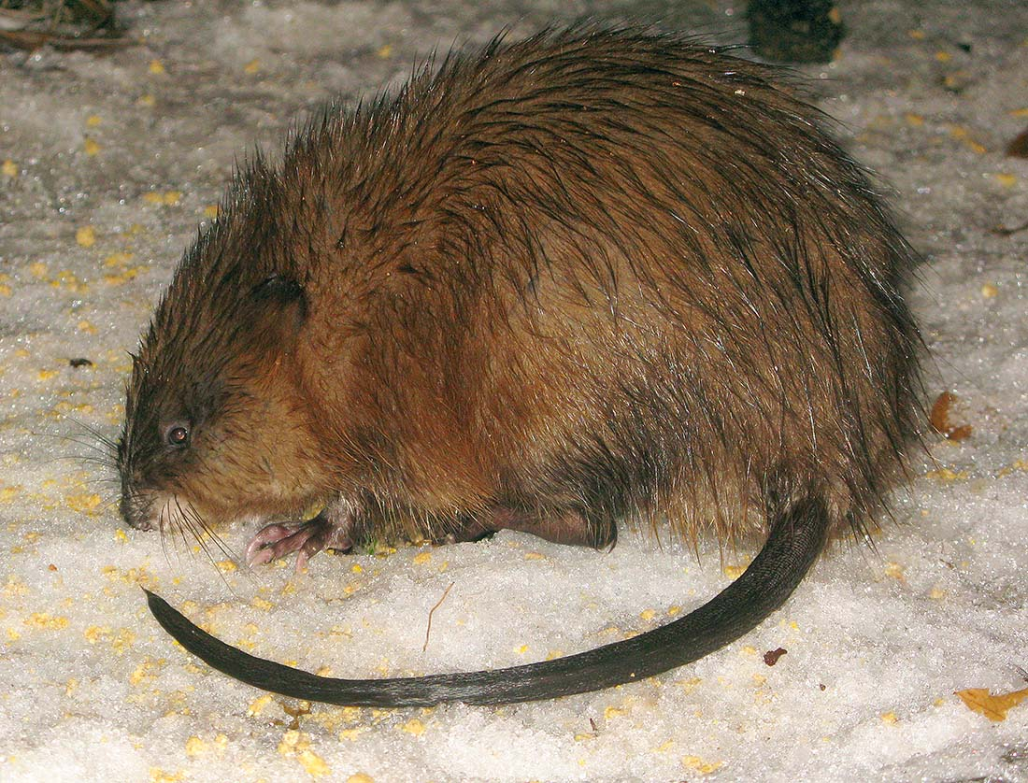
22

Slide 24
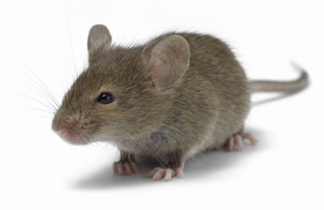
23

Slide 25
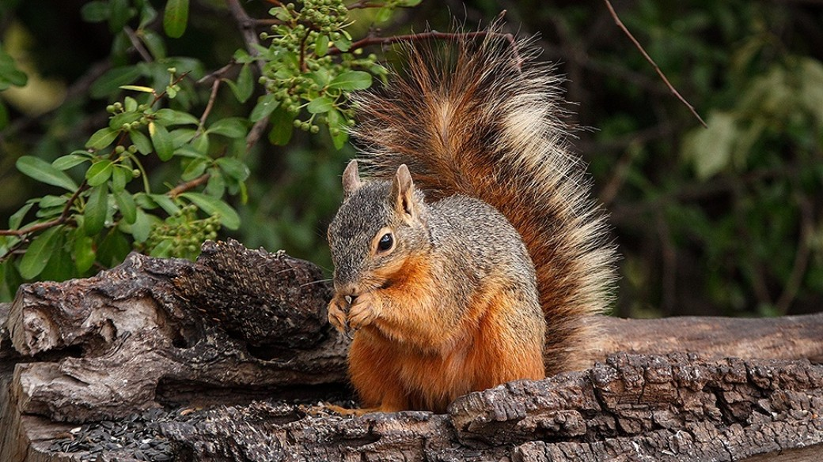
24

Slide 26
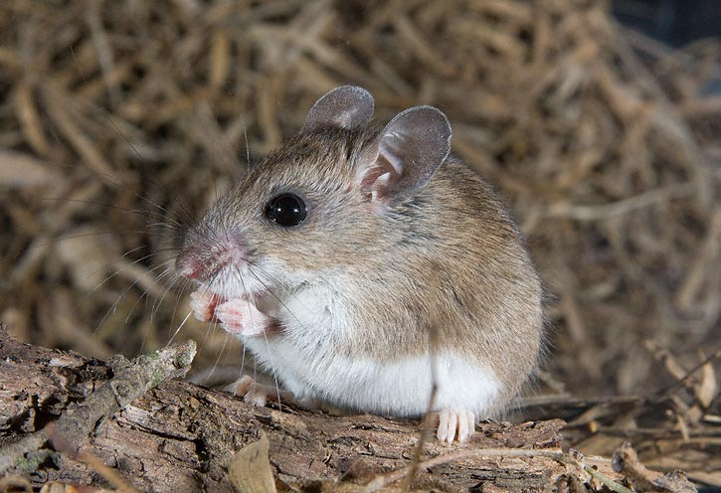
25

Slide 27
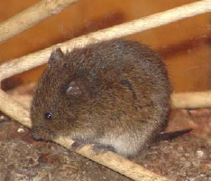
26

Slide 28
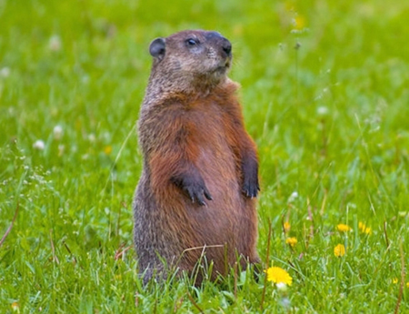
27

Slide 29
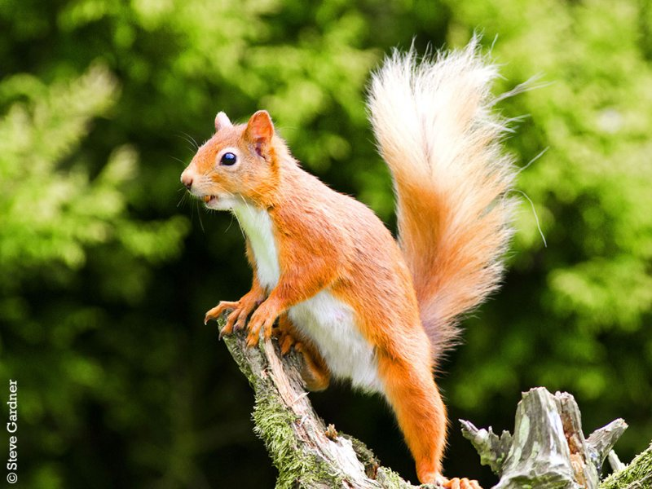
28

Slide 30
Gray Squirrel 15) Chipmunk
Porcupine 16) Gray squirrel
Eastern woodrat 17) Flying squirrel
Flying squirrel 18) Norway rat
White-footed mouse 19) Beaver
Red squirrel 20) Porcupine
Beaver 21) Eastern woodrat
Fox squirrel 22) Muskrat
Chipmunk 23) House mouse
House mouse 24) Fox squirrel
Muskrat 25) White-footed mouse
Meadow vole 26) Meadow vole
Woodchuck (groundhog) 27) Woodchuck (groundhog)
Norway rat 28) Red squirrel

